Slide 1
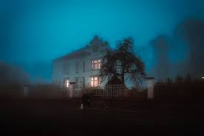
“The Vacation”
Karihwenha:wi Kirby
Type of media: Live Action Film

Slide 2
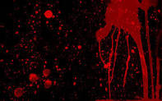
Log Line:
Delirious mother and nimble daughter take a road trip in order to rekindle their relationship. Once they arrive however, they are at a fight for survival.

Slide 3
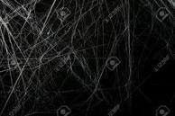
Synopsis:
Afraid that her daughter is detaching from her, young mother Vanessa decides to plan a road trip in order to rekindle their relationship after receiving news that she won a contest to stay at a beautiful home in Ontario. Although daughter Reagan is unappeased with spending time with her mother, she thinks it would be a good adventure to gain inspiration for writing her novel. When they arrive at the home, Reagan immediately feels an eerie presence but her mother is blinded by the beauty of the home. Unusual events transpire which motivates Reagan to investigate the home with her mother. They soon discover that the home owners capture and kill Indigenous people for sport. They are held as prisoners, and Vanessa confronts Reagan as to why she isn't the best mother. They are able to escape by fighting off the home owners and travel back to the reserve where they share the events with community members. The community then prepares to infiltrate and tear down the system.

Slide 4
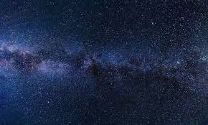
Universe
The universe of the script is set in present day Canada. After winning a contest, Vanessa decides to plan a road trip with her daughter Reagan to Ontario in order to rekindle their relationship. However in the society Indigenous people are under represented and the rich culture is used for exploitation by non Indigenous individuals. The women are in danger of being taken and used for sex trafficking with no help from government officials to find the perpetrators, or gain recognition for the atrocities

Slide 5
Universe:
The city is very wealthy, big buildings tower over each street, thousands of people walking the streets every day. When the two women first enter the city to get to their rental home, large numbers of homeless Indigenous people occupy the sidewalks. Reagan sees a black van pull to the side and force the individuals into the van. Several resistance signs are pinned up on the lamp posts, and abandoned buildings. The rental home is very chic with white walls and marble countertops. It is a two story home with a hidden basement. The bedrooms each have their own bathroom, with towels placed and hung symmetrically. The home clearly shows that the home owners may have OCD. The homes across and down the street are nothing like the rental home. They are small and it reminds Reagan of homes on the reserves. The society is very punctual, and simply too good to be true which unsettles Reagan and pushes her to investigate.

Slide 6
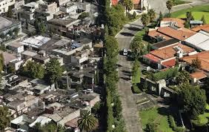
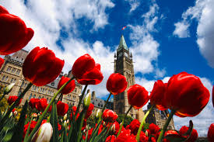
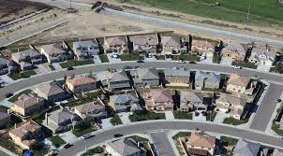
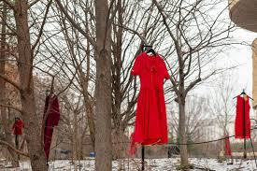
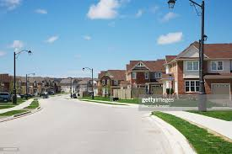
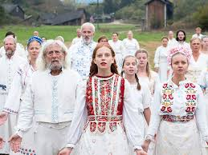

Slide 7
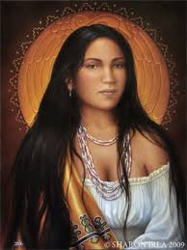
Characters
Vanessa (Mother): She will be the main character in the script. She is 37 years of age but acts as though she is still in her twenties. She has long dark hair always tucked in behind both ears, brown eyes, and prominent bone structure. She had her daughter Reagan when she was eighteen and is trying to live the life she hadn't been able to experience because of her daughter. She has an external conflict with her daughter by forcing her to chase the life she wanted for herself but she does it out of love and support. She will have internal conflict between being a good mother to her daughter and living a fun life.However, an external conflict arises when the home owners attempt to capture the two young girls which is driven by racism. The mother is required to become mature and protect her daughter.

Slide 8
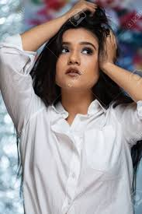
Characters:
Reagan (Daughter): Supporting character in the script. She is 19 years old, very smart, and considers herself to be smarter than her mother and is not afraid to act on it. She has long brown hair, prominent cheekbones, and hazel eyes. She wears a different coloured beaded necklace in every scene, and is an active member in the Indigenous community for solidarity and reconciliation. She has an external conflict with her mother who acts as though she is twenty. I will also add internal conflict as she is deciding whether to leave her mother or stay and remain the “parent” in the relationship. Her goal is to possibly aid in her mother's maturity and escape the vacation home alive.

Slide 9
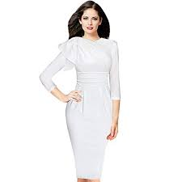
Characters:
Clarice:
Suburban rich wife who owns the luxurious home. She is the definition of the “perfect human being”, her life seems put together and she has it all. She acts very stuck up and a “know it all”. Very dominant in her relationship with her husband, and enjoys taking charge. She hides a very deep hatred for Indigenous people, which is seen through her actions and language.

Slide 10
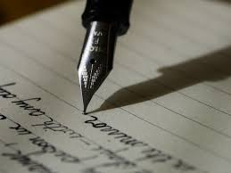
Writers Intention
Indigenous issues such as discrimination and MMIW are rarely ever spoken about in media outlets but it is an enormous epidemic. Indigenous women are of the highest-ranking missing and murdered women in Canada. I wish to spotlight these issues within my script in order to inform readers and hopefully spark conversation to try and eventually obtain the necessary media coverage. In addition, I want people to understand the lives we live, we are not mystical creatures who live in teepees. People need to see us as human beings who live just like everyone else. I wish to tell my story in a conventional manner while developing complex characters. I want Indigenous people to connect and relate to the characters because it is hard for us to see ourselves in non Native actors. Likewise, I will add witty mom jokes, some sarcasm, as well as arguments. I will be focusing on psychological thriller throughout the script without introducing any other genres.

Slide 11
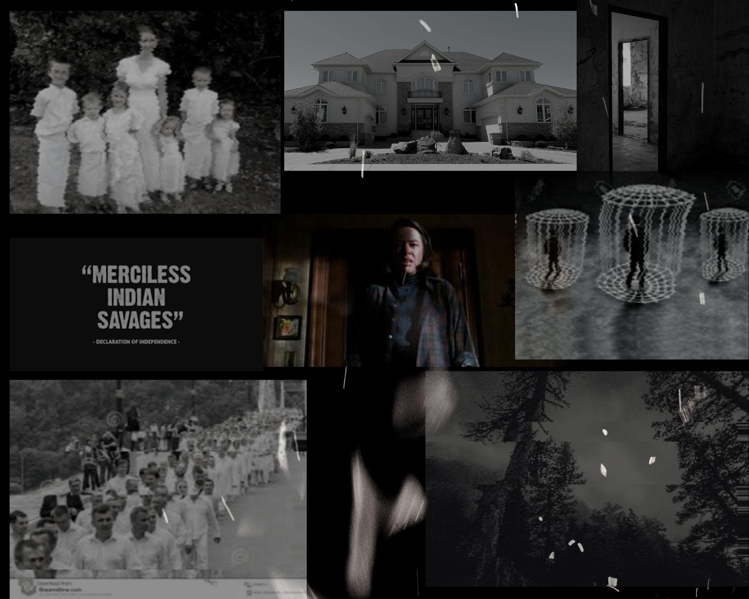
Mood Board

